Slide 1

Thinking about A New Mechanism for Huge Page Management
Lei Liu
with Xinyu Li, Shengjie Yang, Lu Peng, Jiefan Qiu
ACM APSys – 2019, Hangzhou, China
Sys-Inventor Lab, SKLCA, ICT, CAS; LSU; ZJUT
Notes:
Good afternoon, I am Lei Liu from institute of computing technology, Chinese academy of sciences. Today, it is my great pleasure to be here to present our a little bit efforts on thinking about a new mechanism for huge page management.

Slide 2
Executive Summary
Background - Large memory system brings new challenges on memory management
Motivation - Huge page is double-edged
Solutions - SysMon-H and H-Policy
Discussion/Future Work – New memory systems

Slide 3
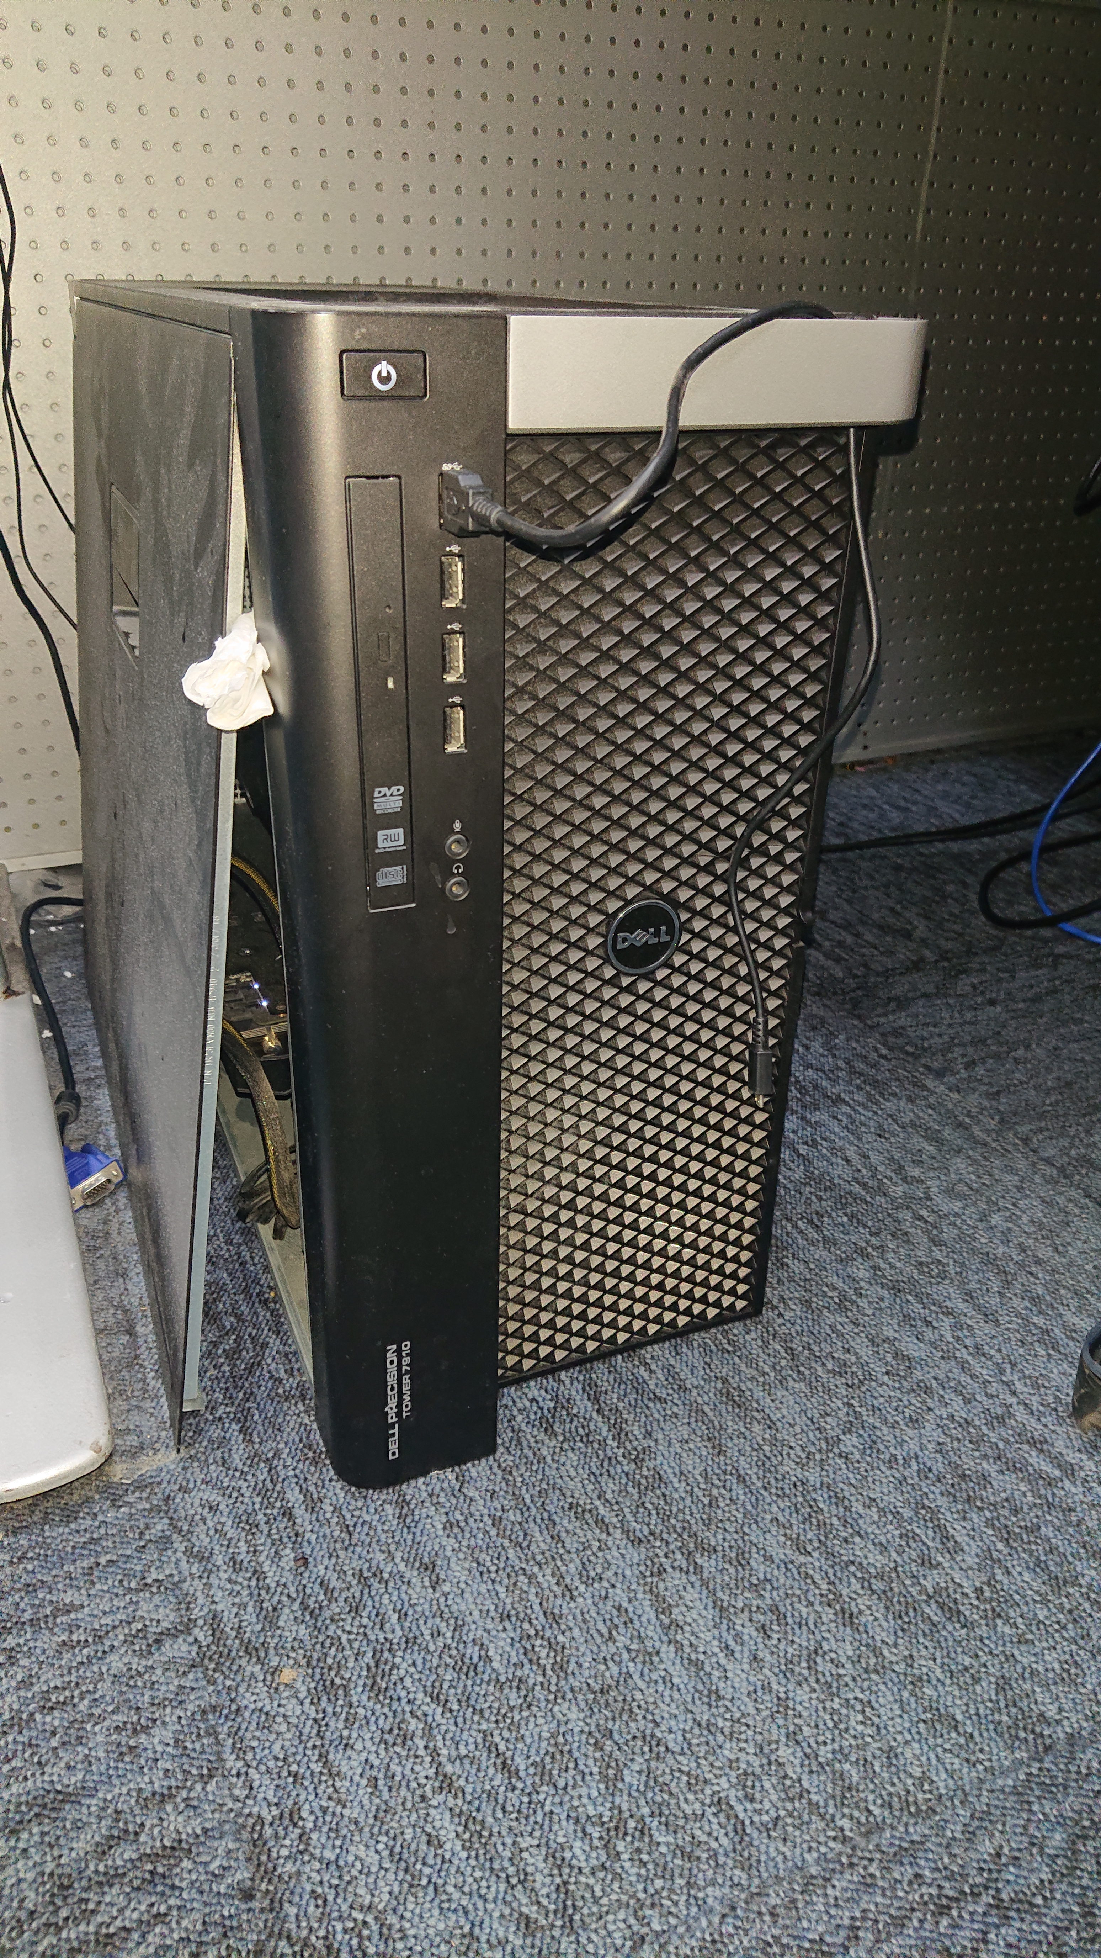
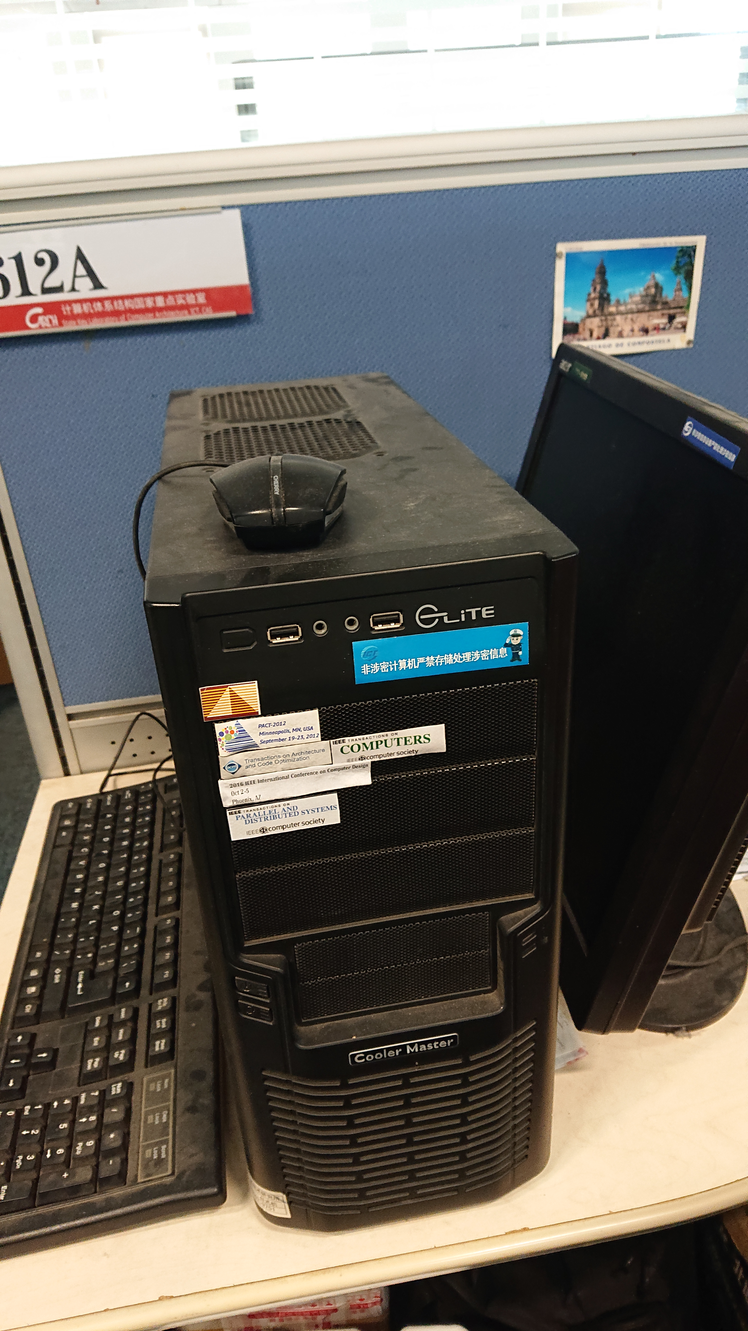
Background - Large Memory System
More ...
8X
2012~2014
At Most 32GB DDR3-1333
2018 ~ Now
256GB DDR4-2333
or More ...
Notes:
We are in the age of big data and cloud computing. And , we now have a large memory system on servers and even the desktops.
Just take my lab as an example, I used to have a server that has at most 32 GB memory several yeas before. However, at present, even my desktop has at least 256 GB memory.
Time changes quickly.

Slide 4
Base Page – 4KB
Small Page has a long history
Advantages:
- Flexible
- Relatively higher utilization
- Internal fragmentation is not that serious
Shortcomings:
High address translation overheads in TLB misses
External fragmentation will be a serious problem in many cloud cases
Notes:
So, how to manage memory in OS?
The memory management uses 4KB base pages in its long history. It is flexible with relatively higher utilization, and the internal fragmentation problem is not very serious.
However, in nowadays, its shortcomings become more and more serious. The high address translation overheads when TLB misses are bottleneck of modern computer architecture. What is more, the external fragmentation will be another serious problem.

Slide 5
Huge Page – 2MB or More
Huge Page seems a better solution
Advantages:
Reducing address translation overheads for modern data processing applications, as TLB scaling has not caught up with the growth of memory capacity in recent times
Minimizing CPU time spent in performing page table lookups by reducing TLB misses [A. Panwar et al, ASPLOS-2019]
Shortcomings:
Low Utilization → Memory Bloating/Memory Waste
Compaction when allocating due to fragments → Latency Spiking
Unfair performance variability
Notes:
Huge page seems a better solution in nowadays.
It can help to reduce the address translation overheads and thus improve the overall system performance.
But just as a coin has its two sides, huge page has its own shortcomings. It always has a low utilization leading to memory bloating and waste memory.
Moreover, memory allocation can incur compaction due to fragments and thus may have the unpredictable performance variability.

Slide 6
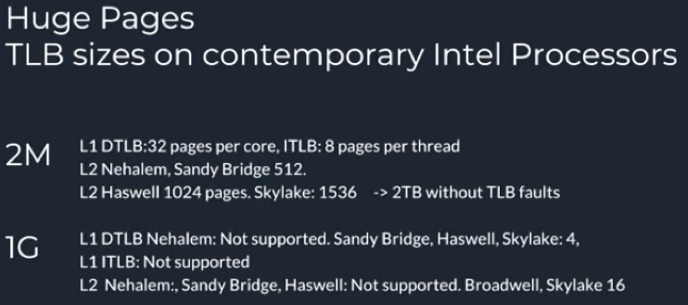
Huge Page and TLB configurations on Intel Platforms
Huge Page needs to be used carefully. TLB is always a scarce resource as TLB scaling has not caught up with the growth of memory capacity.
Credit by Intel Co.
Notes:
Thus, huge page should to be used carefully. Though the number of TLB on today’s machine can be more than a thousand, it is always a scarce resource as TLB scaling has not caught up with the growth of memory capacity in recent times

Slide 7
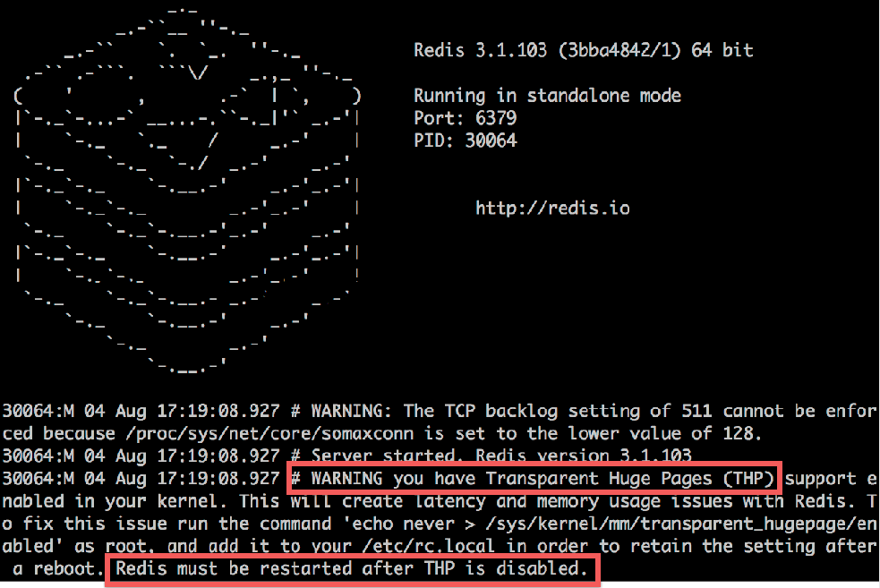
OOPS…. What Happens to Huge Page?
Credit by Y. Kwon et al, OSDI’16 and Redis
Notes:
If it is not used carefully, you will have troubles.

Slide 8
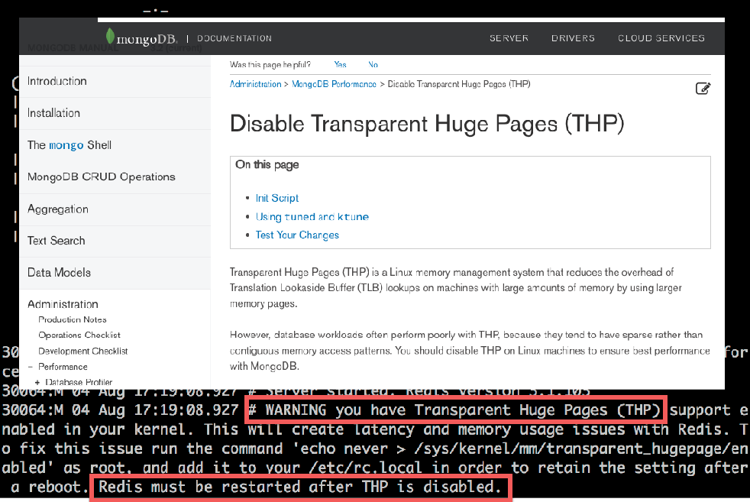
OOPS…. What Happens to Huge Page?
Credit by Y. Kwon et al, OSDI’16 and Wiki
Notes:
As mentioned before, the overall system performance will be unpredictable.
And thus, many cooperation recommend to disable the huge page.

Slide 9
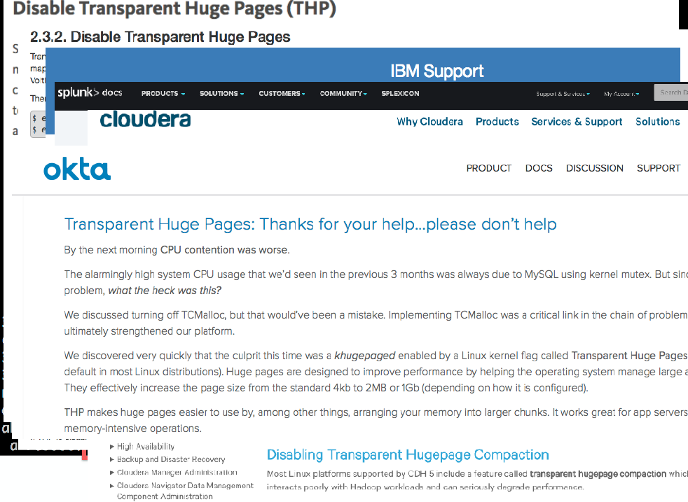
OOPS…. What Happens to Huge Page?
Credit by Y. Kwon et al, OSDI’16 and akta
Notes:
Especially in the cloud computing environments, where the workloads such as memcached, redis are used.

Slide 10

Huge Page – 2MB or More
Huge Page seems a better solution
Advantages:
Reducing address translation overheads for modern data processing applications, as TLB scaling has not caught up with the growth of memory capacity in recent times
Minimizing CPU time spent in performing page table lookups by reducing TLB misses [A. Panwar et al, ASPLOS-2019]
Shortcomings:
Low utilization → Memory bloating/wasting
Compaction when allocating due to fragments → Latency spiking
Unfair performance variability
Notes:
Huge page is not always the free lunch. Our solutions aim to handle these shortcomings.

Slide 11
Our Solution -
A new Mechanism for Huge Page Management
Make OS Know More about Huge Page
Use the information to Manage Memory System within a low overhead

Slide 12
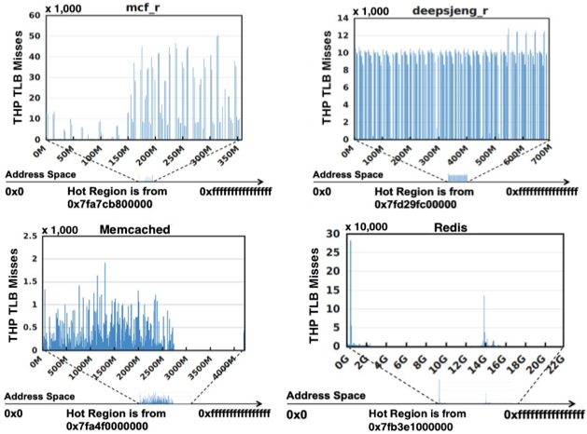
How? – SysMon-H
Monitoring TLB misses to figure out the Hot regions in which huge pages are accessed frequently.
mcf
deepsjeng
Memcached
Redis
An effective method as:
1. Cold pages have only a small num. of TLB misses, but Hot pages have a lot.
2. Page’s TLB entry has the almost equal opportunity to be swapped out. [B. Gras, et al, in USENIX Security 2018]
Notes:
Monitoring TLB misses to figure out the hot regions is an effective approach. Here are several results including both desktop level and cloud level workloads.
In our practice, cold pages only have a small number of TLB misses, but hot pages have a lot.
One may assume that the hot pages will be kept in TLB and thus do not incur tlb misses. However, modern architecture does not allow this design in order to defend the side-channel attack.
Thus, only a very small number of pages belong to this type, but we still have an approach to detect them.

Slide 13
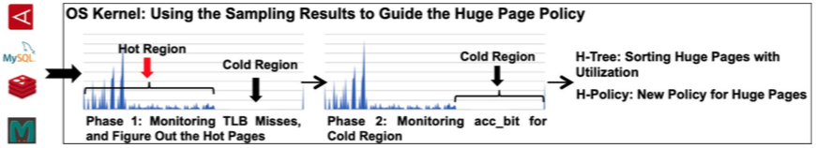
The Overall Working Flow of SysMon-H
Step 1
Step 2
Step1: Monitoring TLB misses to figure out the Hot regions in memory space;
Step2: Monitoring access_bit in PTEs for Cold regions to further check the pages classified as cold ones incorrectly.
After sampling, the OS kernel components will re-organize the huge pages accordingly into H-Tree.
All in OS Kernel

Slide 14
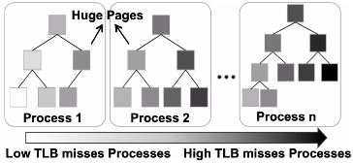
H-Tree: Buddy System is Not the Original
Notes:
Huge Pages are organized according to their utilizations into a binary sorting tree (H-Tree) for each running application;
OS is able to get the huge pages with lower utilizations in low overheads with H-Tree.
Notes:
We reorganize the huge pages to construct an h-tree for each application.
To achieve this goal in Linux, we need to design a new page indexing system and modify the buddy system accordingly.

Slide 15
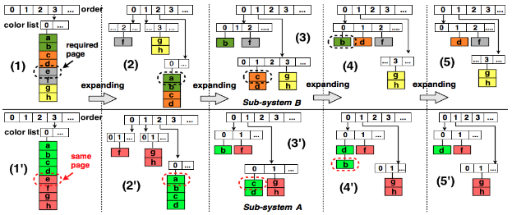
A Case in Practice on Customizing Buddy System in Linux Kernel @ Sys-Inventor Lab
A two tiered buddy system, and each of them meets a specific memory allocation requirement. Two sub-buddy systems work cooperatively.
Lei Liu, et al, Going Vertical in Memory Management, In ACM/IEEE ISCA, 2014
Notes:
We used to customize the buddy system to achieve our specific target.
Through this slide, we would like to show a case in practice several yeas ago.

Slide 16
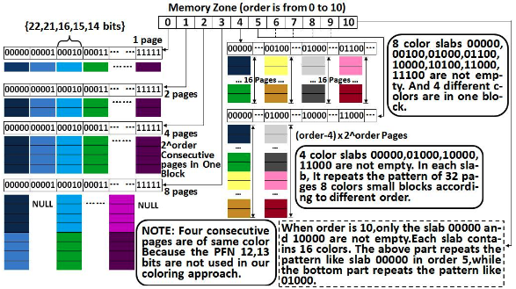
Another Example - Previous Practice in My Lab
An instance for page coloring based physical page organization. Colors indicate the positions in physical memory address. The System can return a page with a target color in any address location w/ constant time.
Lei Liu, et al, Rethinking Memory Management in Modern OS, In IEEE T. on Computers (TC), 2016
Notes:
Another example is using …..
Through these two slides, we would like to show you that customizing the buddy system maybe an effective approach, and this work also needs to modify the buddy system.

Slide 17
H-Tree is Originated from Buddy System in Linux Kernel
Huge Pages are organized according to their utilizations into a binary tree for each running application;
OS is able to get the huge pages with lower utilizations in low overheads to break.
H-Policy is based on H-Tree
An interesting system is ahead!

Slide 18
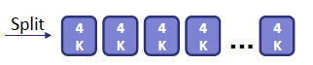
H-Policy: Managing Large Memory Systems (1)
RULE 1 – Mitigating Memory Bloating: When the overall memory utilization achieves 90%, H-Policy will try to break the underutilized huge pages into base 4KB ones.
2 MB
Return
OS

Slide 19
H-Policy: Managing Large Memory Systems (2)
RULE 2 – Promoting 4KB pages: When a consecutive space achieve 90% utilization, it will be promoted to a huge page; page migration will be used to create a higher utilized space.
Promote
2 MB
Migrate
4 KB
…
1. Promoting a consecutive space w/ a high number of TLB misses
2. Migrating pages to create a consecutive physical space w/ high utilization

Slide 20
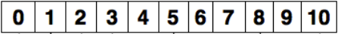

H-Policy: Managing Large Memory Systems (3)
RULE 3 – Treating the “Consecutive” as a Resource: delaying breaking 2⁹ blocks; Creating 2⁹ blocks by merging “holes” within lower orders.
Buddy System’s order slabs
512 pages
2MB
Locked
…
+
+
3. Locking the blocks has 512 4KB pages for huge page allocations, and delaying breaking them.
1. Tracking the “hole”;
2. Merging them using the
IDLE computing resource for efficiency.
In H-Policy, the “consecutive” is a kind of resource, and H-Policy tries to reduce the memory fragmentations.

Slide 21
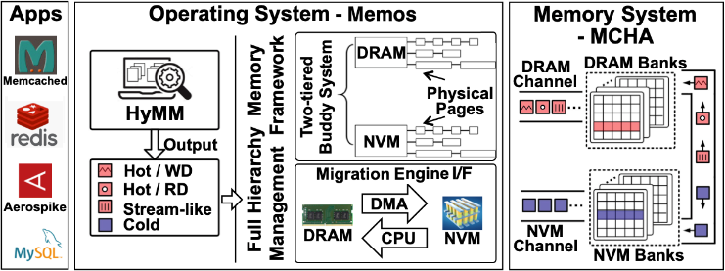
Discussion - Future Work
New Memory Architecture – Non-Volatile Memory is involved and located beside the DRAM memory
It is a potential use case for NVM (large memory capacity) management using huge page in OS.
Lei Liu, et al, Hierarchical Hybrid Memory Management in OS for Tiered Memory, In IEEE TPDS, 2019
Notes:
Recently, we designed a system that use Non-volatile memory. NVM is involved and located beside the DRAM in unified memory address space.
We are now trying to deploy our design on the hybrid memory system. As NVM can provide the large capacity, so it will be an ideal approach to use newly proposed huge page mechanism for NVM.

Slide 22
Conclusions
A new Mechanism for Huge Page Management in OS Kernel for Large Memory Systems
SysMon-H: Make OS Know More about Huge Page
+
H-Policy: Use the information to Manage Memory System with a low overhead
Efficient memory allocation for huge pages
Mitigating the memory bloating and reducing fragmentations
Improving the overall memory utilization
More experimental results can be found in our paper.

Slide 23


Slide 24
Recommended Articles
Youngin Kwon, et al, Coordinated and efficient huge page management with Ingens, in OSDI, 2016
Ashish Panwar, et al, Making huge pages actually useful, in ASPLOS, 2018
Ashish Panwar, et al, HawkEye: Efficient Fine-grained OS Support for huge pages, in ASPLOS, 2019
Neha Agarwal, et al, Thermostat: Application transparent page management for two-tiered main memory, in ASPLOS, 2017
Lei Liu, et al, Hierarchical hybrid memory management in OS for tiered memory systems, in IEEE TPDS, 2019
Lei Liu, et al, Rethinking memory management in modern OS, in IEEE TC, 2016
Lei Liu, et al, Going vertical in memory management: handling multiplicity by multi-policy, in ISCA, 2014

Slide 25
Thinking about A New Mechanism for Huge Page Management
Lei Liu
with Xinyu Li, Shengjie Yang, Lu Peng, Jiefan Qiu
ACM APSys – 2019, Hangzhou, China
Sys-Inventor Lab, SKLCA, ICT, CAS; LSU; ZJUT

